Slide 1
Air Quality Index Prediction
Submitted By :
Nirdosh (M21MA009)
Submitted To:
Dr. Vivek Vijay

Slide 2
Sections
Problem Background
Problem Statement
Why interested for a Data Science student?
Sequential Model Algorithms
Method Follow
Results
Difficulties
Future Plan

Slide 3
Problem Background
Air quality index (AQI) is a measure of air quality which describes the level of air pollution.
Air pollution causes several diseases like strokes, heart diseases, lung cancer, acute and chronic respiratory diseases.
Accurate and reliable air quality index (AQI) prediction is highly crucial to public health and for the ecological environment.

Slide 4
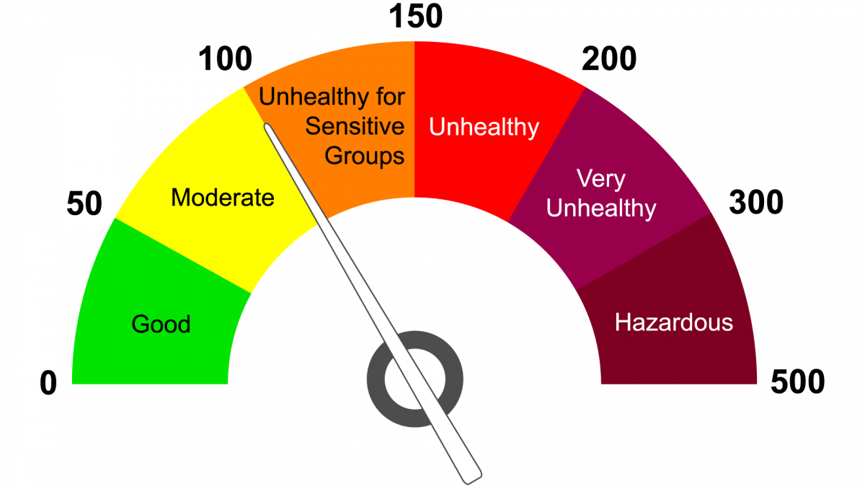
Problem Background
Air Quality Index Range

Slide 5
Problem Statement
In this project, our primary focus is to accurately predicts AQI on the basis of six pollutants concentration in the air.
These six pollutants are PM2.5, PM10, NO2, SO2, CO and O3.
We are predicting AQI using sequential models that are deep learning techniques suitable for time series data.
The main objective of the AQI prediction is to inform and caution the public about the risk of exposure to daily pollution levels.

Slide 6
Why interested for Data Science Student ?
Data Science is a field that gives insights from structured and unstructured data, using different scientific methods and algorithms, and consequently helps in generating insights, making predictions and devising data driver solutions.
It uses a large amount of data to get meaningful insights using statistics and computation for decision making.
Finding out the hidden patterns or insights from the time series data to know the AQI range.
Based on the concentration of pollutants we can predict the Air Quality of Urban and metropolitan areas of India.

Slide 7
Brief about Sequential Models
Why we need it?
Limitations of CNN(Convolutional Neural Network)
In CNN Input and output size is fixed we can’t input image of varying dimensions to the network.
CNN does not have long term dependencies on the data so it can not memorize previous inputs.

Slide 8
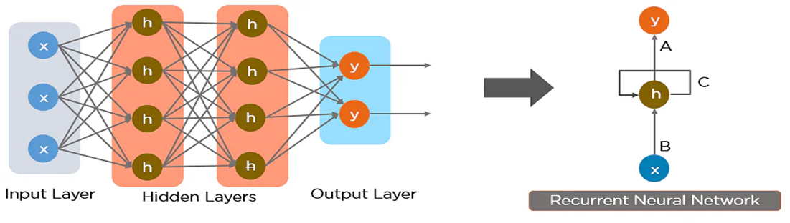
Recurrent Neural Network(RNN)
RNN works on the principle of saving the output of a hidden layer and feeding this back to the hidden layer.

Slide 9
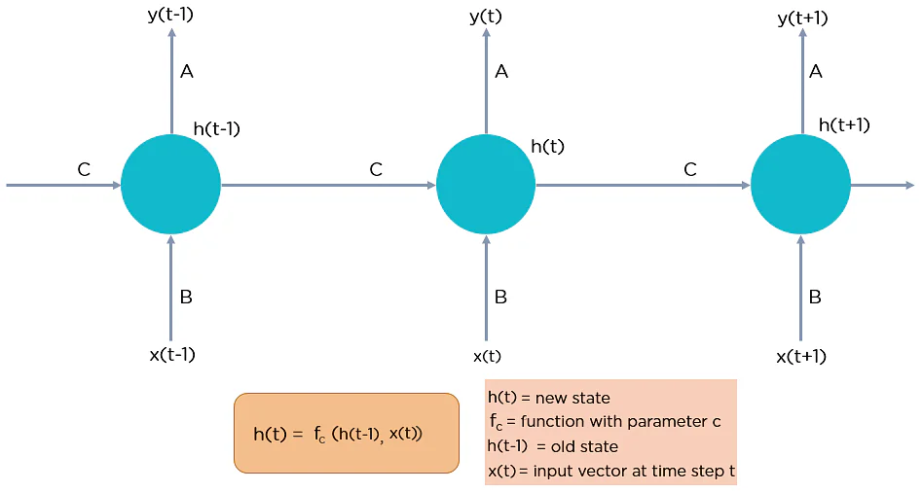

Slide 10
Advantages and Disadvantages of Recurrent Neural Network
Advantages
It can process input of any length.
It can process Sequential data such as text or video.
It is uses for text translation, natural language processing, sentiment analysis and speech analysis.
Disadvantages
RNN have problem of Exploding Gradient and Vanishing Gradient
Computation of RNN network is slow and it cannot process very long sequences if using tanh or relu as an activation function.

Slide 11
Long-Short term memory(LSTM)
LSTMs are a special kind of RNN capable of learning long-term dependencies by remembering information for long periods.
LSTMs have a chain-like structure, but the repeating module is a bit different structure. Instead of having a single neural network layer, four interacting layers are communicating extraordinarily.
A conventional LSTM unit consists of a cell, an input gate, an output gate, and a forget gate.

Slide 12
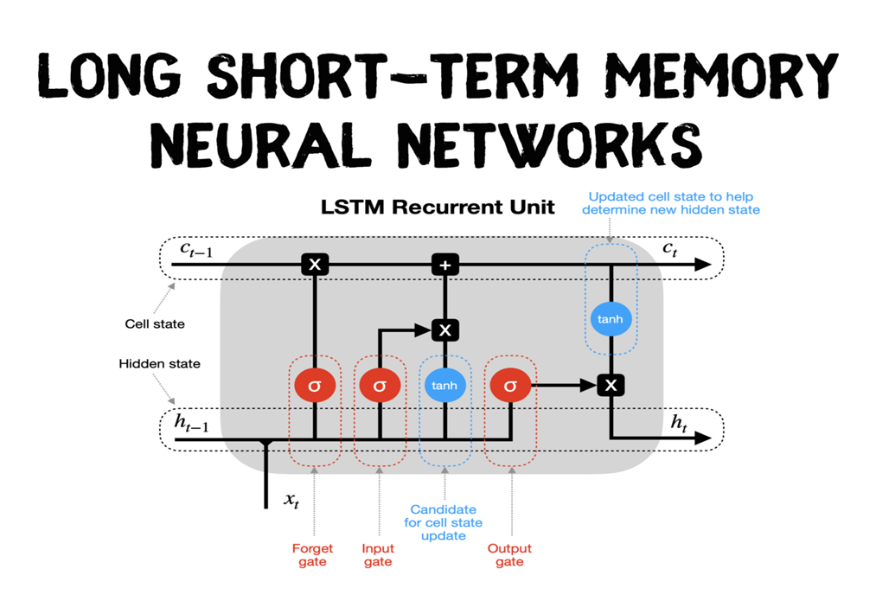

Slide 13
Working of LSTM
Hidden state & new inputs : hidden state from a previous timestep (h_t-1) and the input at a current timestep (x_t) are combined before passing copies of it through various gates.
Forget gate : this gate controls what information should be forgotten. Since the sigmoid function ranges between 0 and 1, it sets which values in the cell state should be discarded (multiplied by 0), remembered (multiplied by 1), or partially remembered (multiplied by some value between 0 and 1).
Input gate : helps to identify important elements that need to be added to the cell state. Note that the results of the input gate get multiplied by the cell state candidate, with only the information deemed important by the input gate being added to the cell state.

Slide 14
Working of LSTM
Update cell state : first, the previous cell state (c_t-1) gets multiplied by the results of the forget gate. Then we add new information from [input gate × cell state candidate] to get the latest cell state (c_t).
Update hidden state : the last part is to update the hidden state. The latest cell state (c_t) is passed through the tanh activation function and multiplied by the results of the output gate.
Finally, the latest cell state (c_t) and the hidden state (h_t) go back into the recurrent unit, and the process repeats at timestep t+1. The loop continues until we reach the end of the sequence.

Slide 15
Method Follow
For Predicting AQI , I’m using the Nested LSTM which is a variant of LSTM network.
The Nested LSTM neural network, is used to enhance prediction performance by remembering more data from the historical data.
One additional LSTM memory cell is nested inside the initial LSTM memory cell by an Nested LSTM memory cell.
Overall, this structure strengthens the original LSTM network structure’s resilience, making it possible to memorize and analyze longer-term historical information.

Slide 16
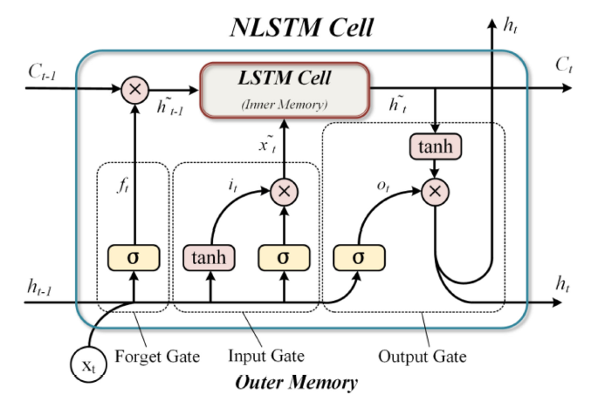

Slide 17
Existing Available Dataset
For predicting AQI, the original AQI data are collected from 12 observing stations around Beijing from year 2013 to 2017. The original sensor data are collected in an hourly time step, across 1461 days. The total number of hourly data samples is 35,064 Each hourly recorded dataset consists of multiple variables and six of them are utilized in this model, namely, PM2.5, PM10, SO2, NO2, CO, and O3.

Slide 18
Steps
Data loading and Data pre-processing
Data Normalisation getting data into certain range of values.
Wavelet transform for data stabilization.
Dividing dataset into train set and test set.
Training predicting using Nested LSTM neural network.
Result denormalisation.
Output prediction result.
Evaluation of result.

Slide 19
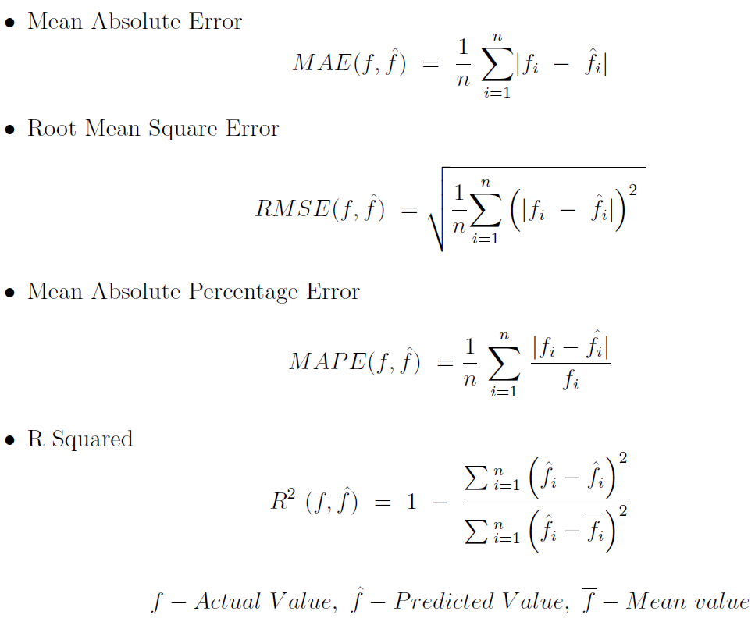
Evaluation Metrics

Slide 20
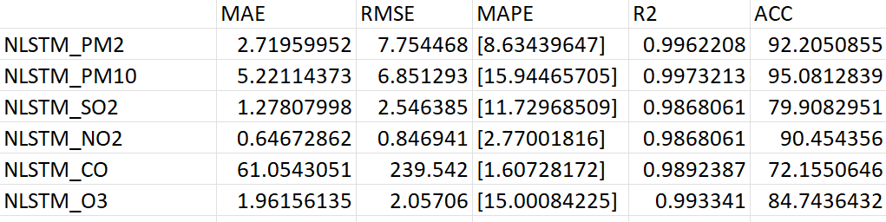
Results

Slide 21
Difficulties
Finding the dataset for these six pollutants daily concentrations data for Jodhpur City is not available after 2020.
Missing data interval in between the intervals of the time series are regular but some values are simply not present.
Data type issues like sudden changes in data types during data ingestion. Float values may start coming in strings. An extra type casting is required here.

Slide 22
Future Plan
Work on Time series data analysis to understand the core concepts of forecasting.
Creating a dataset of six parameters of pollutants data hourly. At starting level, create a small dataset at the first level and eventually let it expand.
Exploring the Recurrent Neural Networks, i.e., LSTM.
Predicting accurately and reliable AQI.

Slide 23
Thank You

